Slide 1

Rate and Speed
Mathematics
Primary Four - 120 Minutes

Slide 2

The Strike Rate

Slide 3
Overview
What is Rate?
Rate in everyday situations
Understanding key concepts -
Rate
Total quantity
Number of Units
Solving real life issue

Slide 4
What is rate?
How can we send a birthday cake via courier to a friend staying in different city?
How can we find the usage of electricity in home?
How can we control overspilling issue in the school/home?
Notes:
Here you can discuss about the idea of as we increase the weight of cake, the charges will be more.
Based on the number of units used we can find out the Electricity Bill.

Slide 5

What will happen?
100ml
200ml
400ml
Notes:
This is a hands on experiment.
From Concrete-Pictorial-Abstract model of mathematical learning, this focuses on concrete understanding of the concept.

Slide 6
Definitions
Rate
Total Quantity
No of units

Slide 7
More about Rate

Slide 8
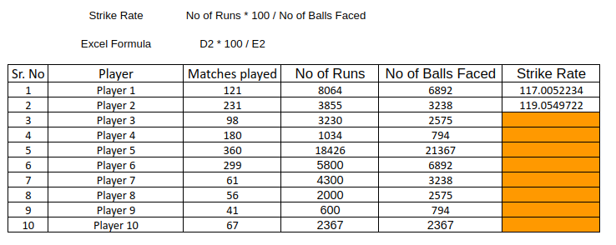
Group 1 - What is my strike rate?
Notes:
This is a simple task.
Apply the formula given and find out the strike rate of all the players.
This task is simple one and can be allotted to the group with basic skills.

Slide 9
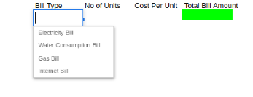
Group 2 - Bill Calculator
Notes:
A slightly difficult task.
We don’t know any value and we need to define the formula.
This task can be given to the group of students who has good understanding of the basic arithmetic operations.

Slide 10
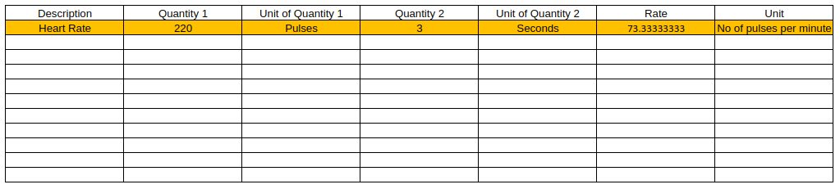
Group 3 - The Mix-n-Match Calculator

Slide 11
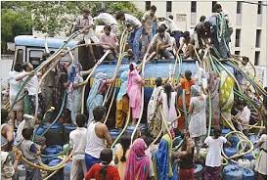
The Water Crisis

Slide 12


Let us empathize - Water Scarcity

Slide 13

The problem
Water scarcity is the lack of sufficient available water resources to meet the demands of water usage within a region.

Slide 14
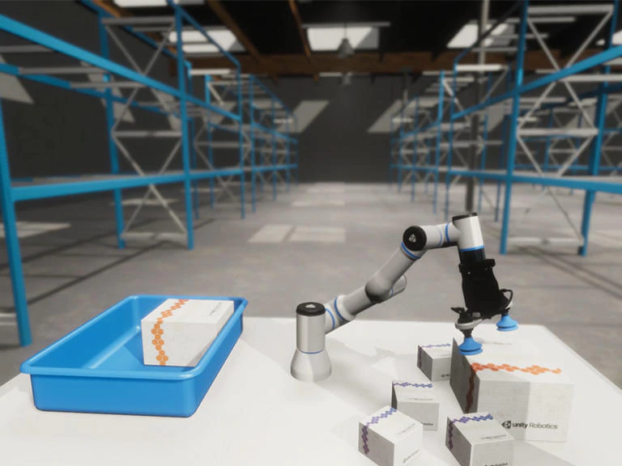
Simulation of the solution

Slide 15
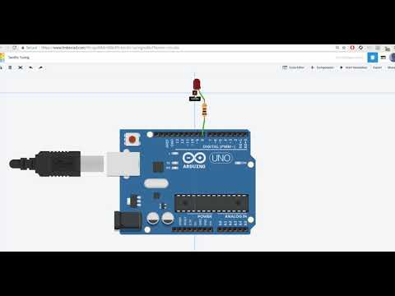
Working with Arduino UNO using TinkerCAD

Slide 16
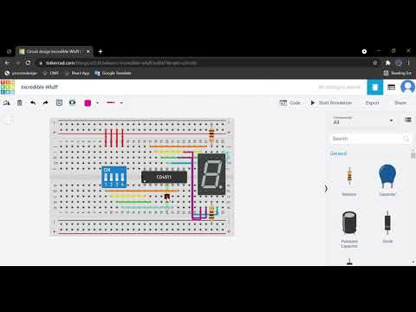
Working with Switches and 7-Segment using TinkerCAD

Slide 17
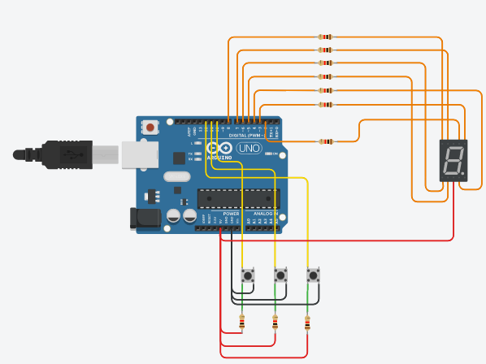
Circuit Design

Slide 18
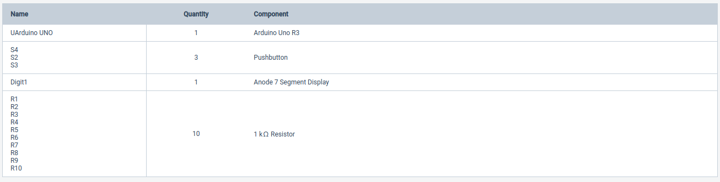
Component List

Slide 19
What can we do more?
How can we automate the solution?
Are there any sensors we can use to replace the switches?

Slide 20
Conclusion
Rate, in simple words, is a change in one quantity with respect to change in the other related quantity.
Given any two quantities, the rate, the total amount, the number of units, and the third quantity can be calculated.
Examples
We can measure heart rate as number of heart beats per second.
We can measure utility bills charges per unit.
We can measure strike rate of a batsmen as number of runs scored on every ball.
Rate is something which we need to consider while looking at quantities.
Rate at which we cover a distance is speed, but rate of change speed is acceleration.

